Slide 1
Computer Networks Week2 OSI Model
Presented By
Subhalaxmi Chakraborty

Slide 2
In 1984, the OSI model was formally adopted by ISO as an international standard
OSI stands for Open Systems Interconnection and consists of 7 Layers
Open Systems Interconnection (OSI) model,
a conceptual framework that describes the functions of a networking or telecommunication system.
In this case, we may need several protocols, for each layer.

Slide 3
A protocol is a set of rules that govern the data communication .It represents the agreement between two communicating devices.
When communication is not simple, we may divide the complex task of communication into several layers.

Slide 4
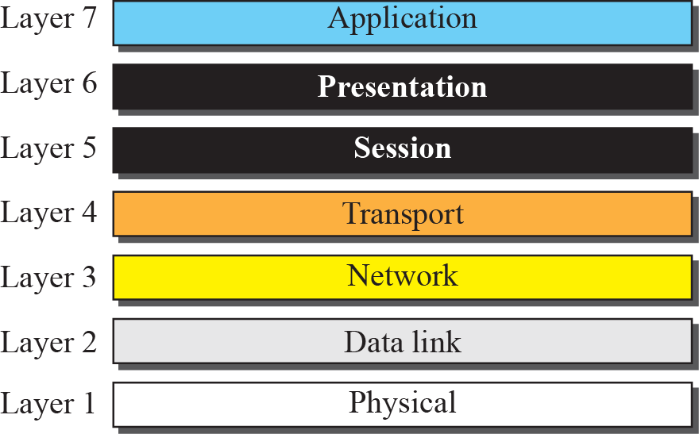
7 layers of OSI Model

Slide 5
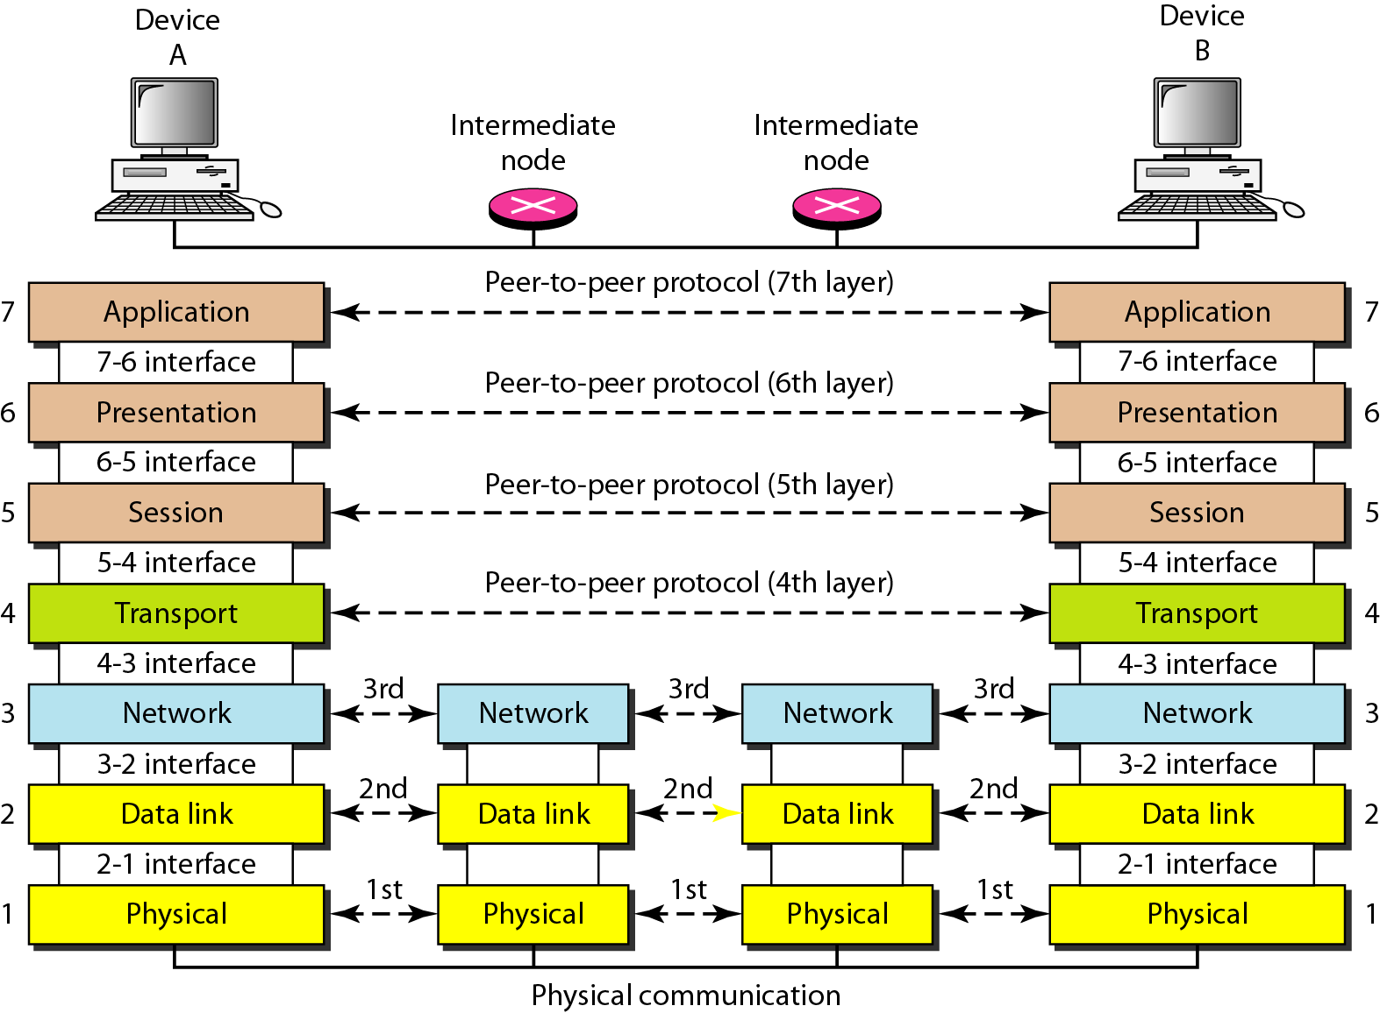
Interfaces b/w Layers

Slide 6
OSI in Action
OSI Model
A message begins at the top application layer and moves down the OSI layers to the bottom physical layer.
As the message descends, each successive OSI model layer adds a header to it.
A header is layer-specific information that basically explains what functions the layer carried out.
Conversely, at the receiving end, headers are striped from the message as it travels up the corresponding layers.

Slide 7
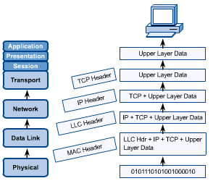

Slide 8
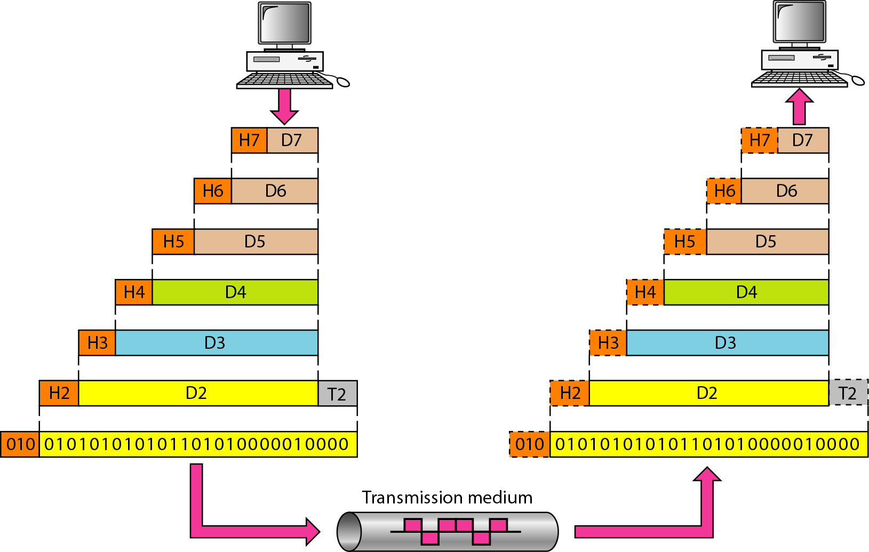
Data Communication using the OSI Model

Slide 9
Layer7- Application Layer
In the OSI model, this is the layer that is the “closest to the end user”.
Communication at the application layer is between two processes running at the two host.
A web browser (Google Chrome, Firefox, Safari, etc.) or other app - Skype, Outlook, Office - are examples of Layer 7 applications.

Slide 10
Application layer defines how application processes(clients and servers) are running on different end systems and pass messages to each other.
Protocols of Application layer
HTTP- Hypertext Transfer Protocol
SMTP- Simple Mail Transfer Protocol
FTP- File Transfer Protocol
TELNET- Terminal Network- (for accessing a site remotely)

Slide 11
Presentation Layer
The presentation layer is an important layer in the OSI model because it is responsible for some of the important services like
Data conversion
Data compression (JPEG)
Data encryption, and decryption (PGP= Pretty Good Privacy), SSL (Secured Socket Layer)

Slide 12
Session Layer
The session layer establishes a session between the source and the destination nodes , manages and terminates sessions on completion of the communication process.
The protocols used are:
PPTP- Point-to-Point Protocol
SAP-Session Announcement Protocol

Slide 13
Transport Layer
The transport layer works on two determined communication modes:
Connection oriented and connectionless
This layer transmits data from source to destination node.
It uses the most important protocols of OSI protocol family, which are:
Transmission Control Protocol (TCP)
User Datagram Protocol (UDP)

Slide 14
TCP vs UDP
TCP is a connection oriented protocol which establishes a connection a logical connection between transport layers at two hosts
TCP provides flow control, error control
TCP allows retransmission of packets
UDP is a connectionless protocol
UDP does not provide flow control, error control
UDP does not allow retransmission of packets

Slide 15
Network Layer
The network layer is responsible for the delivery of individual packets from the source host to the destination host.
Logical addressing
Routing
The network layer assists the following protocols:
Internet Protocol (IPv4)
Internet Protocol (IPv6)
ICMP- Internet Control Message Protocol
It helps IP to report some problems when routing a packet

Slide 16
End to end delivery of packets
Creates logical paths
Path determination (routing)
Hides the lower layers making things hardware independent
Uses logical hierarchical addresses
Devices: routers

Slide 17
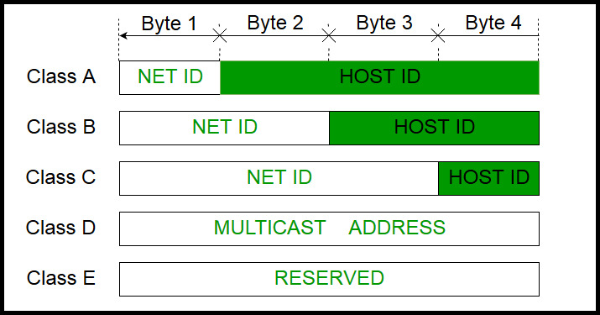
Different IP classes

Slide 18
Data link Layer
Devices: switches, bridges, NIC(Network Interface card)
Data link layer has two sub-layers:
Logical Link Control(LLC): It deals with protocols, flow-control, and error control
Media Access Control: It deals with actual control of media

Slide 19
The data link layer is responsible for moving frames from one hop (node) to the next.
Framing
Physical addressing
Flow control
Error control
Access control

Slide 20
Functionality of Data-link Layer
Framing
Data-link layer takes packets from Network Layer and encapsulates them into Frames. Then, it sends each frame bit-by-bit on the hardware. At receiver’ end, data link layer picks up signals from hardware and assembles them into frames.
-Character oriented framing
-Bit oriented framing

Slide 21
Addressing
Data-link layer provides layer-2 hardware addressing mechanism. Hardware address /Physical Address/MAC address is assumed to be unique on the link. It is encoded into hardware at the time of manufacturing.
MAC is 6 byte code embedded in NIC.

Slide 22
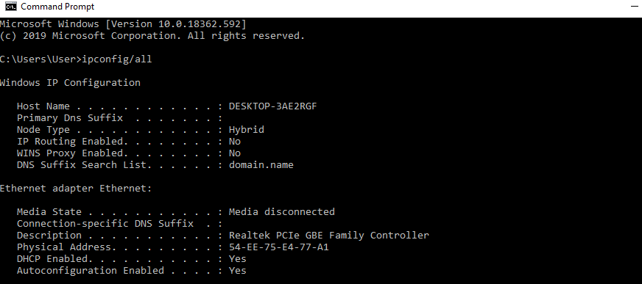

Slide 23
Error Control
Sometimes signals may have encountered problem in transition and the bits are flipped. These errors are detected and attempted to recover actual data bits. It also provides error reporting mechanism to the sender.
Flow Control
Stations on same link may have different speed or capacity. Data-link layer ensures flow control that enables both machine to exchange data on same speed.

Slide 24
Multi-Access
When host on the shared link tries to transfer the data, it has a high probability of collision.
Data-link layer provides mechanism such as CSMA/CD and CSMA/CA to equip capability of accessing a shared media among multiple Systems.
*CSMA/CD- Carrier Sense Multiple Access/ Collision Detection
* CSMA/CA- Carrier Sense Multiple Access/ Collision Avoidance

Slide 25
Physical Layer
The physical layer is responsible for movements of individual bits from one hop (node) to the next.
Physical characteristics of interface and medium: pin assignment, connector, cables
Representation of bits: Linecoding, Modulation
Data rate- Bit rate, Baud rate
Synchronization of bits
Line configuration: point-to-point, multipoint
Physical topology
Transmission mode: simplex, half-duplex, full-duplex

Slide 26
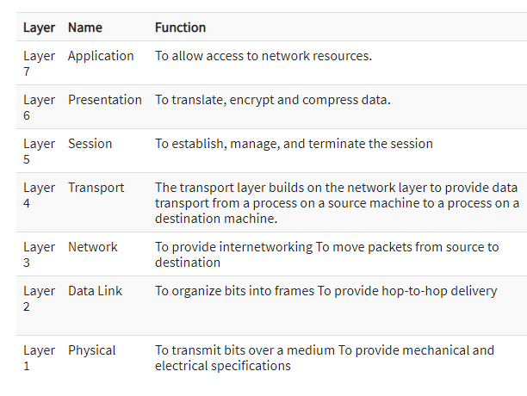

Slide 27
The TCP/IP protocol suite was developed prior to the OSI model.
Therefore, the layers in the TCP/IP protocol suite do not match exactly with those in the OSI model.
Today, however, TCP/IP is thought of as a five-layer model with the layers named similarly to the ones in the OSI model.

Slide 28
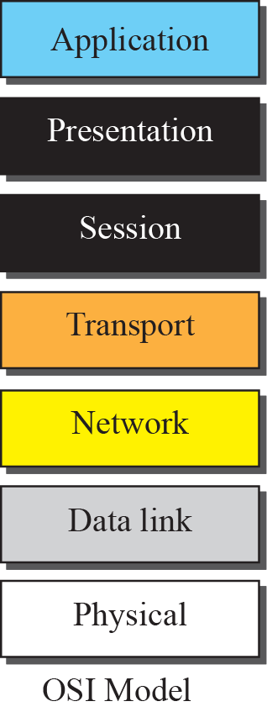
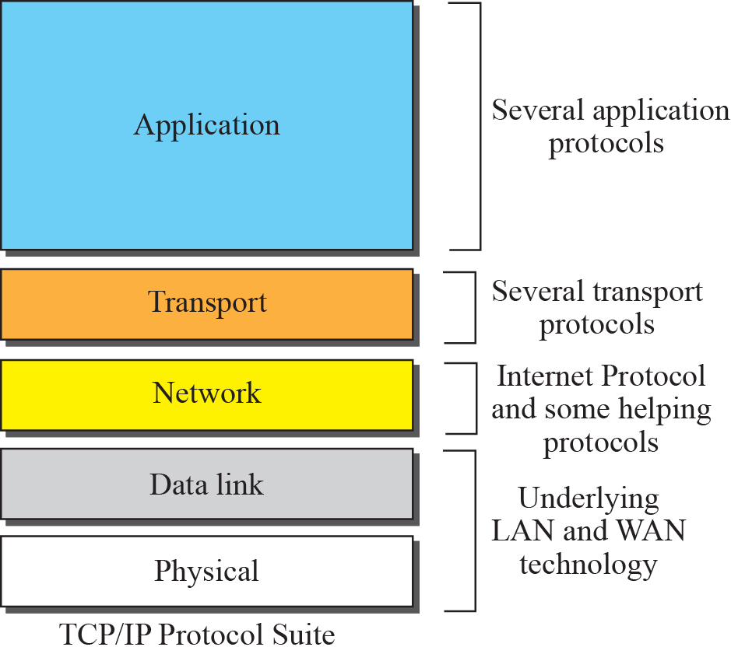
TCP/IP and OSI model

Slide 29
Q &A
What are the advantages of a multipoint connection over a point-to-point connection?
What is the difference between half-duplex and full-duplex transmission modes?
Name the four basic network topologies, and cite an advantage of each type.
For n devices in a network, what is the number of cable links required for a mesh, ring, bus, and star topology?
What is an internet? What is the Internet?
Why are protocols needed?
What is standard?
In the ring topology in what happens if one of the stations is unplugged?
In the bus topology, what happens if one of the stations is unplugged?
Explain why do we need n(n-1)/2 number of links in mesh topology?

